Slide 1
Database Design

Slide 2
Day 3

Slide 3
Logical Data Model
Notes:
Logical data model is the source of information for the physical design phase

Slide 4
Logical Data Model
Refinement of the work done in the conceptual phase
Represents data in details as much as possible
Basis for building Physical data models
Notes:
Enforce appropriate standards to be used in the documentation of design
Failure to standardize documentation often lead to poor design work
Most of the data-modeling process, are not necessarily performed sequentially, but in an iterative manner

Slide 5
Steps in Logical Modeling
Identifying attributes and domains
Look for items that identify and describe the entities
Example: For Person entity, attributes might include Citizenship no., height, hair color, address
Domain information for an attribute is generally discovered at the same time as the attributes
Common types of attributes to look for:
Identifiers: information used to identity a single instance of an entity
Descriptive Information: information used to describe something about the entity
Values: things that quantify something about the entity
Notes:
Domain is a pool of values from which one or more attributes draw their values
Concept of domain is used to specify template for data type and columns
Domain information helps to maintain consistency

Slide 6
Logical Modeling for Example Scenario
Identifying attributes and domains for entities and relationships
Entity | Description | Domain
users | Customers of streaming service
Attributes: user_id name user_name signup_date birth_date email_address phone_number country | Identifier for user entity, SK, PK First Name + Last Name Preferred name while using service Date when account was created Date of Birth Valid email address of the user More than one users can have same phone Country Code, FK | Auto Generated Text Text + Number, Unique DateTime Date Unique Valid phone number Valid id from country table
Notes:
Simple/Composite attributes:
Whether attributes is simple or composite
Option to represent name as simple or composite determined by user requirements
How does the user access the name?
Single/Multivalued:
Attributes can hold multiple values for single entity instance
Can a user have multiple phone number?
Q/A: In the users model, does the phone_number needs to be unique?
Derived
Whose values are based on values of other attributes
Age of user

Slide 7
Relationship Attributes
Every relationship that’s identified might imply bits of data to support it.
For example, Consider a relationship between user and song ie. User plays Songs.
This relationship implies that some sort of value might be present to count the number of times a song is played by a user.

Slide 8
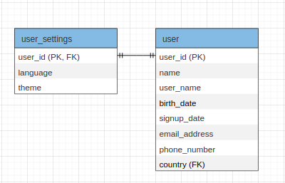
Example Scenario: 1 to 1 Mapping
Notes:
1:1 is least common type of relationship in the data model, Few 1:1 relationships exist in real life
Example:
1:1 → Country , Capital
1:M → Country, City
Most 1:1 relationship are 1:1 for only certain period of time, if time component is included in the data model, 1:1 will be converted into 1:M or M:N
Capital city for a country can change
Q/A: Is employee-manager relationship in Vyaguta 1:1? Since all the employees are in the same table, how does referencing work?
Weak Entity:
Cannot exist without an entity with which it has a relationship
Entity has PK that is partially or totally derived from parent entity

Slide 9
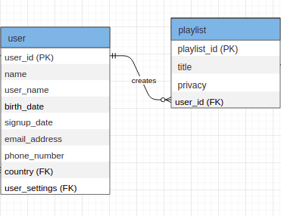
Example Scenario: 1 to M Mapping
Notes:
Most common relationship
Q/A: Similar to previous implementation, why playlist table cannot use user_id as both primary and foreign key?

Slide 10
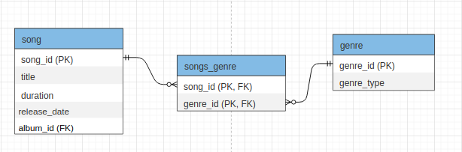
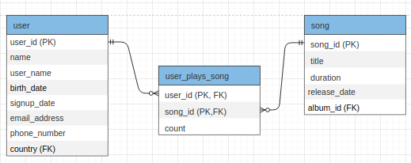
Example Scenario: M to N Mapping
Notes:
M:N relationship is not supported directly in the relational environment
Implemented by creating a bridge entity with 1:M relationship between the original entities
Which primary key to use? : either combination of both FKs or a new PK
Additional attributes can be added to bridge entity
Bridge entity contains multiple occurrence of FKs, Does this creates redundancy

Slide 11
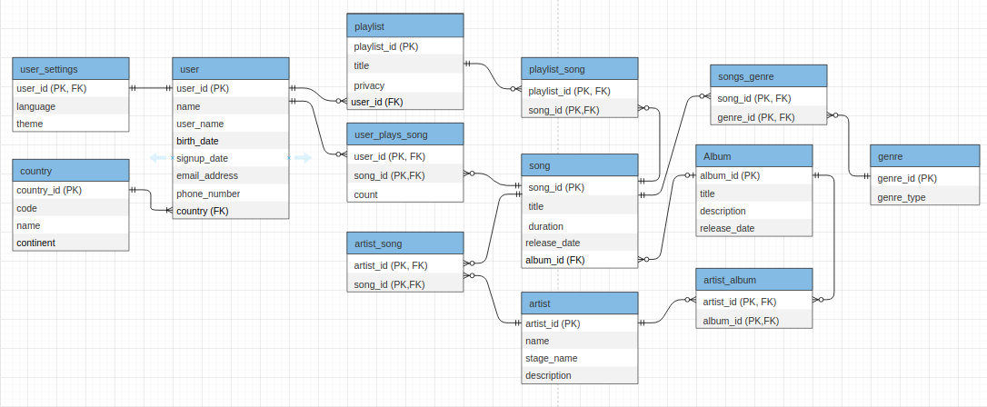
Example Scenario: Final Logical Model
Notes:
Validate against user transactions
Check integrity constraints
What integrity checks are required rather than how this might be achieved
Required data
Attribute domain
Multiplicity
Entity and referential integrity

Slide 12
Normalization
Notes:
Why normalization
Problems with redundant data
How normalization can be used in database design
Concept of functional dependencies
UNF → BCNF

Slide 13
Normalization
Systematic approach of decomposing table to reduce or even eliminate data redundancy and maintain data integrity
Normalization produces highly cohesive and loosely coupled data schemas
A highly normalized data schema will store the data in one place only, reducing the possibility of inconsistent data
Normalization usually comes at a performance cost
One must resist the temptation to go too far during normalization
Process of normalization is based on a set of levels, each of which satisfies certain rules, also known as normal forms.
Notes:
Normalization- formal technique than can be used at any stage of database design
Two main approaches:
Bottom up standalone database design technique
Validation technique to check the structure of ER modeling

Slide 14
Normal Forms
Particular set of rules that can be used to test a table structure
Each normal form is build on the precept that the lower forms have been compiled with
Types of Normal Forms
First Normal Form (1NF)
Second Normal Form (2NF)
Third Normal Form (3NF)
Boyce–Codd Normal Form (BCNF)
With the exception of 1NF, all other normal forms are based on functional dependencies
Higher normal forms beyond BCNF such as 4NF, 5NF deals with situations that are rare

Slide 15
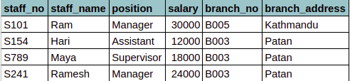
Data Redundancy and Anomalies
Let’s look at the following table. Details of branch are repeated for every member of the staff located at that branch.
Insert Anomaly: Inability to add data due to absence of another data
Delete Anomaly: Unintended loss of data due to deletion of another data
Update Anomaly: Data inconsistency due to partial update and data redundancy
Notes:
Insert Anomaly:
If new staff is to be added, branch details should be added as well and this should be consistent with existing data.
To insert new branch, that currently has no staff, it is necessary to enter null values for other columns. Since staff_no is a PK, attempting to enter nulls violates entity integrity
Delete Anomaly:
Delete a records that represents the last staff located at that branch, the details of the branch are also lost from the database.
Update Anomaly:
If branch_address for B003 has to be updated, multiple rows should be updated. If not, database will become inconsistent.

Slide 16
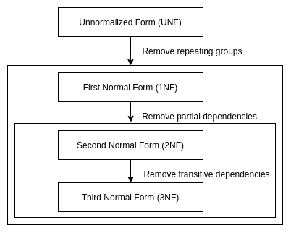
Process of Normalization
Notes:
2 important properties associated with decomposition of larger relations into smaller relations
Loseless-join: any instance of original relation can be identified from corresponding instances from smaller relations
Dependency preservation: constraint on original relationship can be maintained by simply enforcing some constraint on each of smaller relations

Slide 17
First Normal Form (1NF)
An entity type is in first normal form (1NF) when
Tables contains atomic values only
Each records are unique
Values stored in a column are of same domain
To transform the unnormalized table to 1NF, identify and remove repeating groups of data
Repeating group is an attribute or group of attributes, within a table, that occurs with multiple values for a single occurrence of the nominated key
Common approaches for removing repeating groups
Flattening the tables
Placing the repeated data in separate relation

Slide 18
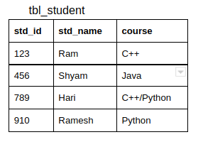
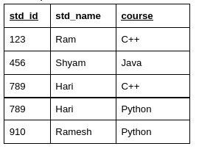
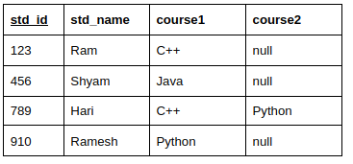
1NF Example:
Consider a UNF table
Approach 1: Flattening Table
Notes:
Flattening: creating extra rows or columns for redundant data
Flattening tables can create more redundancy than the UNF
If only student is taking more than 10 courses, the second representation will include unnecessary amount of rows

Slide 19
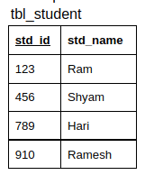
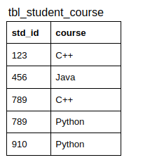
1NF Example:
Approach 2: Create two or more relations with less redundancy

Slide 20
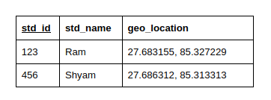
Reasonability of Atomicity
Variation on atomicity can be seen for complex data types
Complex data types can contain more than one values as long as
There are always same number of values
The values are rarely dealt individually
Meaning cannot be expressed with single value
Example: Let’s say, geographic location need to be added to student table
Notes:
If you get the data broken down to the level in which you will query it, life will be easier, SQL will be easier to write

